Slide 1
Capstone Project: Sentiment Analysis
Team members:
Devashish Bose
Rajesh More
Sweety Junnarkar
Akshay Rai

Slide 2
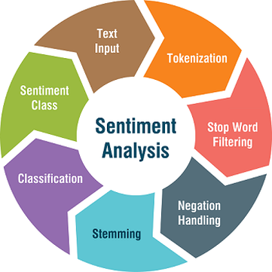
Content
Introduction.
Exploratory Data Analysis.
Data Preprocessing.
Vectorization.
Classification.
Evaluation.
Challenges.
Conclusion.
Q&A

Slide 3
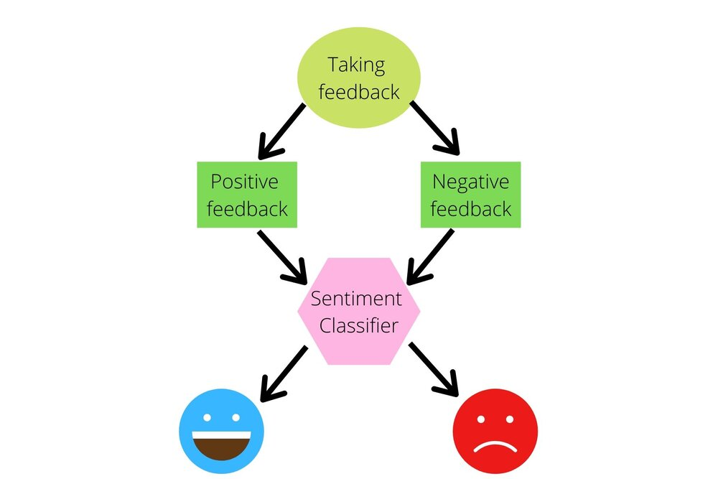
Problem Statement
The challenge is to build a CLASSIFICATION MODEL to predict the sentiment of COVID-19 tweets.The tweets have been pulled from Twitter and manual tagging has been done then.
We are given the following information:
Location
Tweet At
Original Tweet
Sentiment

Slide 4
Introduction
Sentiment Analysis is the process of computationally identifying and categorizing opinions expressed in a piece of text, especially in order to determine whether the writer's attitude towards a particular topic is positive, negative, or neutral.
COVID-19 originally known as Coronavirus Disease of 2019, has been declared as a pandemic by World Health Organization (WHO) on 11th March 2020.
The study analyzes various types of tweets gathered during the pandemic times hence can be useful in policy making to safeguard the countries by demystifying the pertinent facts and information.

Slide 5
Let’s Guess Some Tweets: Negative, Neutral Or Positive?
“Still shocked by the number of #Toronto supermarket employees working without some sort of mask. We all know by now, employees can be asymptomatic while spreading #coronavirus”.
“Was at Supermarket today.Didn’t buy toilet paper”.
“Due to the Covid-19 situation, we have increased demand for all food products. The wait time may be longer for all online orders, particularly beef share and freezer packs. We thank you for your patience during this time”.
Notes:
Negative Neutral and Positive

Slide 6
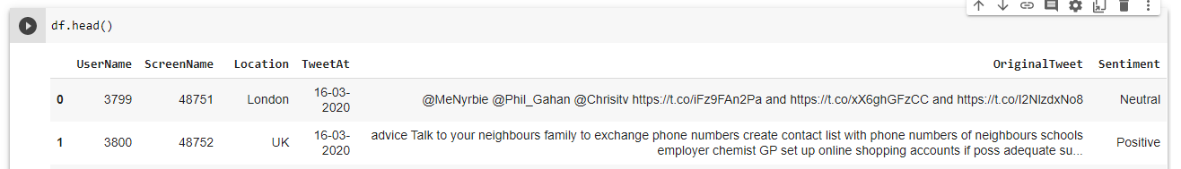
Data Summary
The original dataset has 6 columns and 41157 rows.
In order to analyse various sentiments, We require just two columns named Original Tweet and Sentiment.
There are four types of sentiments- Extremely Negative, Negative, Neutral, Positive and Extremely Positive.

Slide 7
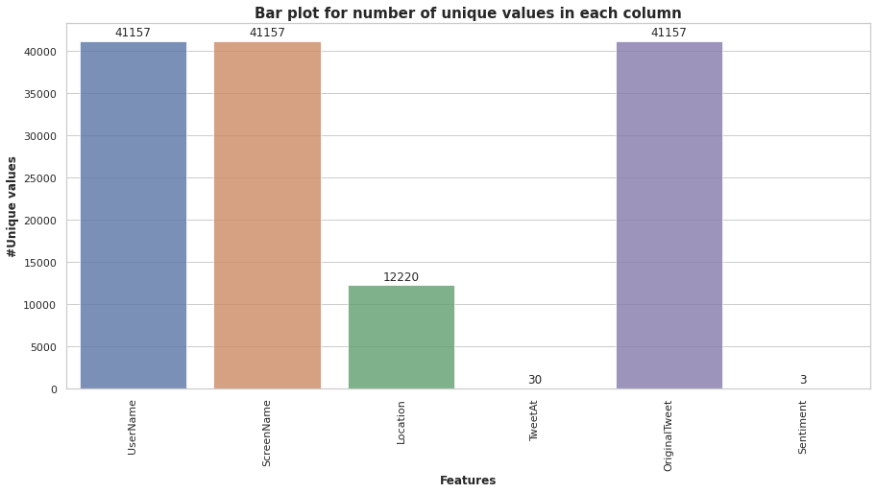
Exploratory Data Analysis
The columns such as “UserName” and “ScreenName” does not give any meaningful insights for our analysis.
All tweets data collected from the months of March and April 2020.
Bar plot shows us the number of unique values in each column.

Slide 8
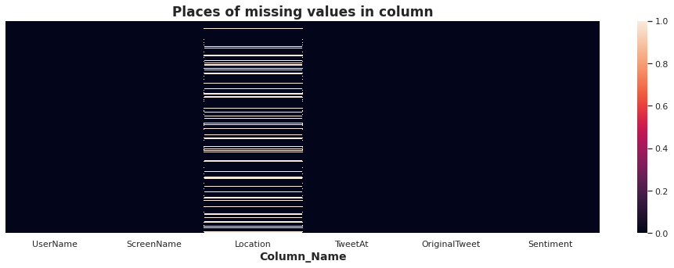
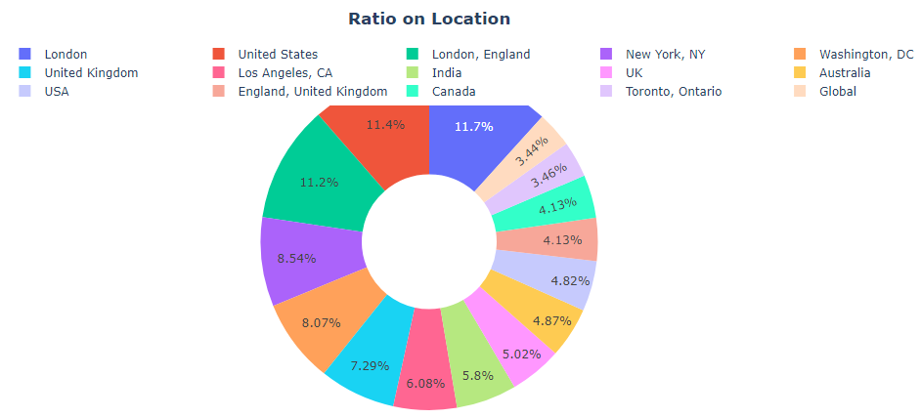
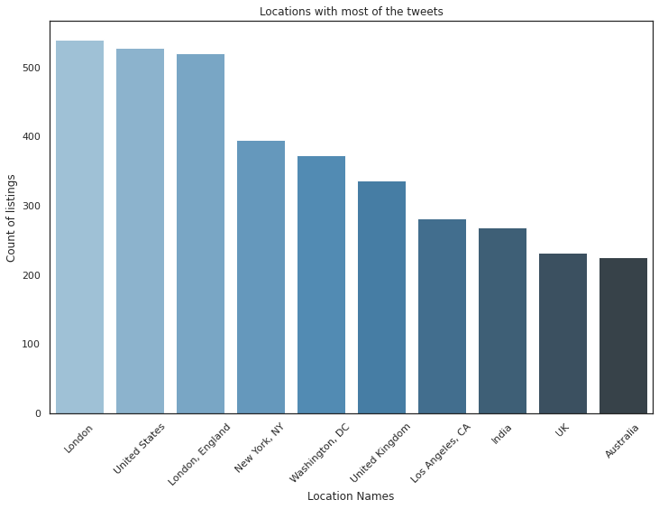
Exploratory Data Analysis: Location
There are 20.87%(8567) null values in various places of location column.
Most of the tweets came from London followed by U.S.

Slide 9
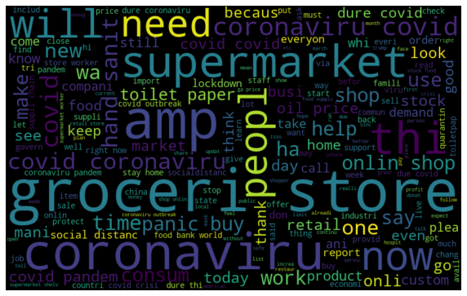
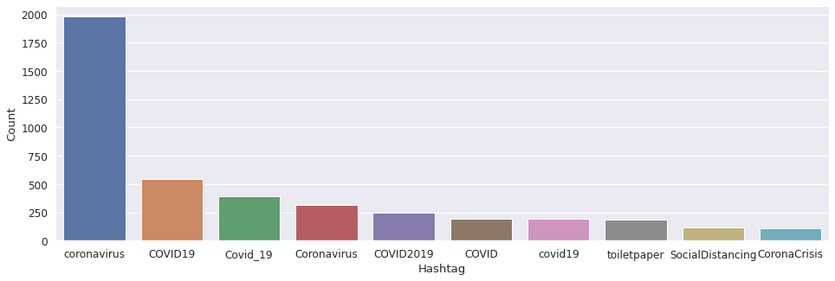
EDA On “Original Tweet” Column.
There are some words like ‘coronavirus’,’grocery store’, having the maximum frequency in our dataset.
There are various #hashtags in tweets column.But they are almost same in all sentiments.

Slide 10
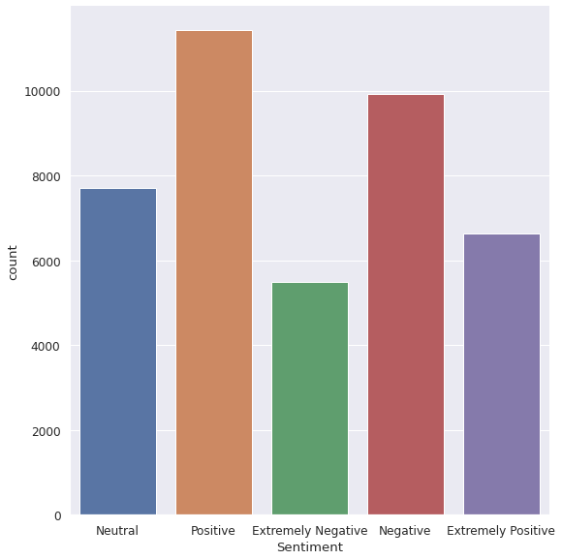
EDA On Sentiment Column.
Most of the peoples are having positive sentiments about various issues shows us their optimism during pandemic times.
Very few people are having extremely negatives thoughts about Covid-19.

Slide 11
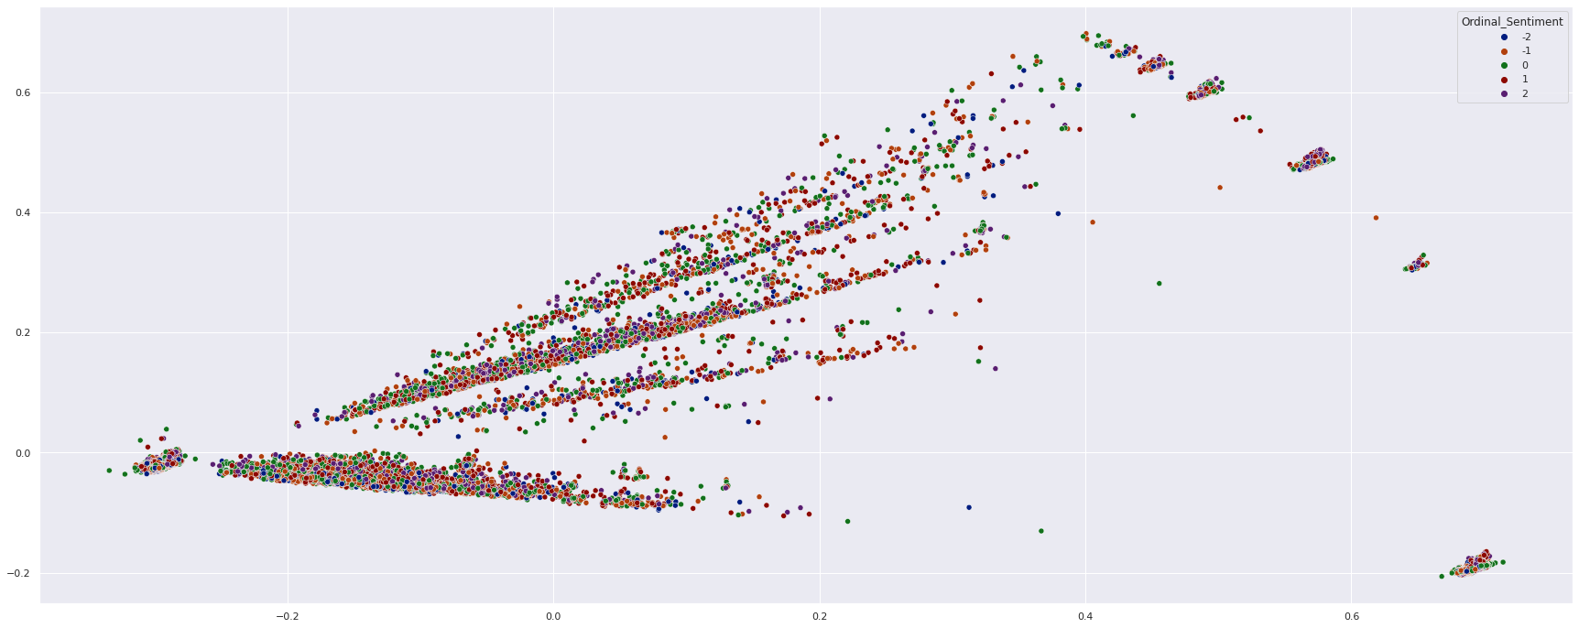
Dimensionality reduction using PCA.
We used PCA to reduce the features into two dimensions.
W

Slide 12
Data Preprocessing
The preprocessing of the text data is an essential step as it makes the raw text ready for mining.
The objective of this step is to clean noise those are less relevant to find the sentiment of tweets such as punctuation, special characters, numbers, and terms which don’t carry much weightage in context to the text.

Slide 13
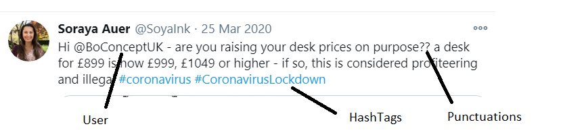
Text Processing on Tweet
wewe

Slide 14
Removing Tweeter Handle(@user)
As mentioned earlier, the tweets contain lots of twitter handles (@user). We will remove all these twitter handles from the data as they don’t convey much information.

Slide 15
Removing Hashtags(#)
We have analyzed that most of the tweets are like #coronavirus #covid-19 and this tweets are almost present in all the sentiments. So there is no use of keeping these hashtags in text. It will make the data noisy and which will affect accuracy of model.
Before-
After-

Slide 16

Removing links(https: / http:)
We are having twitter links in the data which are not useful for our
Model. It will make our data noisy.
Before -
After -

Slide 17
Removing Punctuations, Numbers, and Special Characters
As discussed, punctuations, numbers and special characters do not help much. It is better to remove them from the text just as we removed the twitter handles,links and hashtags.
Before-
After-

Slide 18
Removing Stopwords
Stop words are those words in natural language that have a very little meaning, such as "is", "an", "the", etc.To remove stop words from a sentence, you can divide your text into words and then remove the word if it exits in the list of stop words provided by NLTK.
Before -
After -

Slide 19
Stemming
Stemming is a rule-based process of stripping the suffixes (“ing”, “ly”, “es”, “ed”, “s” etc) from a word.
For example – “play”, “player”, “played”, “plays” and “playing” are the different variations of the word – “play”.
Before -
After -
After -

Slide 20
Lemmatization
Lemmatization is a more powerful operation, and it takes into consideration morphological analysis of the words. It returns the lemma which is the base form of all its inflectional forms.
Before -
After -

Slide 21
Tokenization
In tokenization we convert group of sentence into token . It is also called text segmentation or lexical analysis. It is basically splitting data into small chunk of words.
Tokenization in python can be done by python NLTK library’s word_tokenize() function.

Slide 22
Vectorization
We chose Count Vectorizer as our Vectorizer with minimum document frequency =10.
It will create a sparse matrix of all words and the number of times they are present in a document.

Slide 23
Classification
Models Used:
Naive Bayes
Logistic Regression
Random Forest
XGBoost
Support Vector Machines
CatBoost
Stochastic Gradient Descent

Slide 24
Naive Bayes
Why Naive Bayes?
Good accuracy for classification if the feature independence condition holds.
Space and time effective.
Can handle high dimensional data pretty well.
A good baseline model.
Multi class classification accuracy:
training accuracy Score : 0.6931511009870919
Validation accuracy Score : 0.47947035957240036

Slide 25
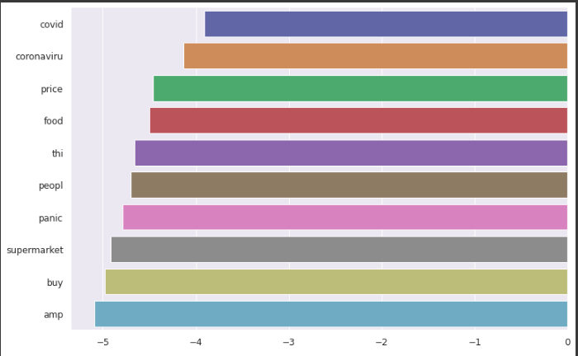
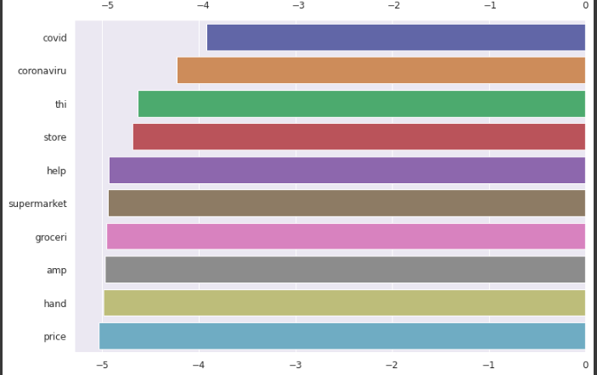
Naive Bayes
Feature Log Probabilities
Neutral
Positive

Slide 26
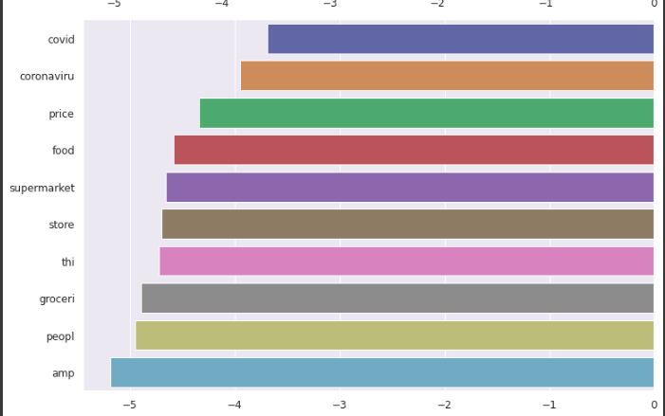
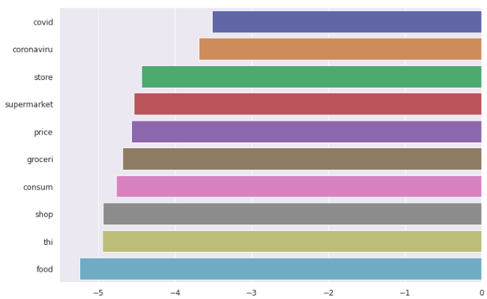
Naive Bayes
Feature Log Probabilities
Extremely Negative
Positive

Slide 27
Naive Bayes
What’s the problem?
Misclassifying samples to the similar groups because of same likelihood of words to be classified in a particular class.
Solution:
Binary Classification.
Binary Classification accuracy :
training accuracy Score : 0.8585573272589218
Validation accuracy Score : 0.7916666666666666

Slide 28
Logistic Regression
Why Logistic Regression?
Unlike Naive Bayes it makes no assumption about the feature independence.
Logistic Regression with L1 regularization is well known for feature reduction.
Fast to train.
Binary Classification Accuracy:
Training accuracy Score : 0.937798025816249
Validation accuracy Score : 0.8594509232264335

Slide 29
Random Forest
Why Random Forest?
Random Forest takes random samples and features to make train the model.
Time taking, but Decision tree like model with less chance to overfit.
Binary Classification accuracy:
Training accuracy Score : 0.9985725132877753
Validation accuracy Score : 0.8299319727891157

Slide 30
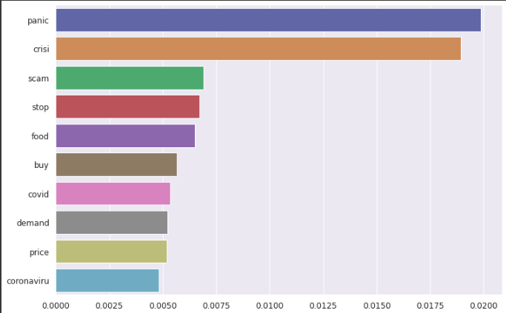
Random Forest
Feature Importance

Slide 31
XGBoost
Why XGB?
Can be used with different objective functions.
Handling missing values.
Built in cross validation.
Binary Accuracy Score:
Training accuracy Score : 0.7434776006074412
Validation accuracy Score : 0.7395529640427599

Slide 32
Support Vector Machines
Why Support Vector Classifier?
It is well known to handle high dimensional data.
It allows misclassification as well with soft margins.
Binary Classification accuracy:
Training accuracy Score : 0.9569020501138952
Validation accuracy Score : 0.8456025267249757

Slide 33
CatBoost
Why Support Vector Classifier?
It is good in handling sophisticated categorical features.
Uses symmetric trees, which result in a Fast Inference.
For multiple classes:
Training accuracy Score : 0.6703720577069097
Validation accuracy Score : 0.6203838678328474
For binary classes:
Training accuracy Score : 0.8840091116173121
Validation accuracy Score : 0.8521622934888241

Slide 34
Stochastic Gradient Descent
Why SGD?
It is neural network based.
It converges comparatively faster for large datasets.
It fits one sample at a time.
Computationally Fast.
Binary Classification Accuracy:
Training accuracy Score : 0.9350949126803341
Validation accuracy Score : 0.8624878522837707

Slide 35
Evaluation
Multi-class Classification
Model | Test accuracy
CatBoost | 62.0%
Logistic Regression | 61.8%
Support Vector Machines | 60.7%
Stochastic Gradient Descent | 57.3%
Random Forest | 56.0%
XGBoost | 48.7%
Naive Bayes | 47.9%
Binary Classification
Model | Test accuracy
Stochastic Gradient Descent | 86.2%
Logistic Regression | 85.9%
CatBoost | 85.2%
Support Vector Machines | 84.6%
Random Forest | 82.9%
Naive Bayes | 79.2%
XGBoost | 74.0%

Slide 36
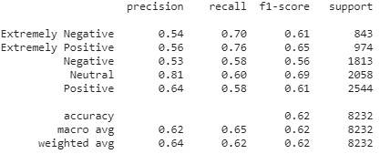
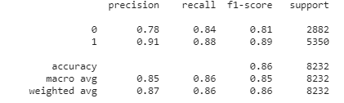
Evaluation (contd.)
Multi-class Classification Winner - CatBoost
Binary Classification Winner- Stochastic Grad. Descent

Slide 37
Challenges
Locations being too many/unformatted/irrelevant
Sarcastic tweets
Advertisements tagged as positive
Computation time/crashes

Slide 38
Conclusion
For multiclass classification, the best model for this dataset would be CatBoost
For binary classification, the best model for this dataset would be Stochastic Gradient Descent
To end it on a lighter note, a few funny tweets we came across:

Slide 39
Q & A

